Slide 1
Data Structure & Algorithm
Lecture#10

Slide 2

Graph Traversal
There are two main ways to traverse a graph:
Breadth First Search (visit and explore the node completely before visiting new one)
Depth First Search (visit and when you reach at new vertex start exploring that)

Slide 3
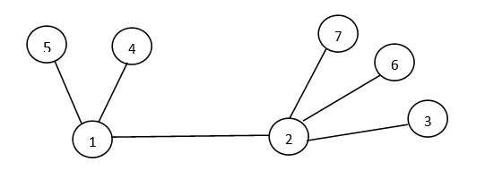
Breadth First Search
Output:
1 2 4 5 3 6 7

Slide 4
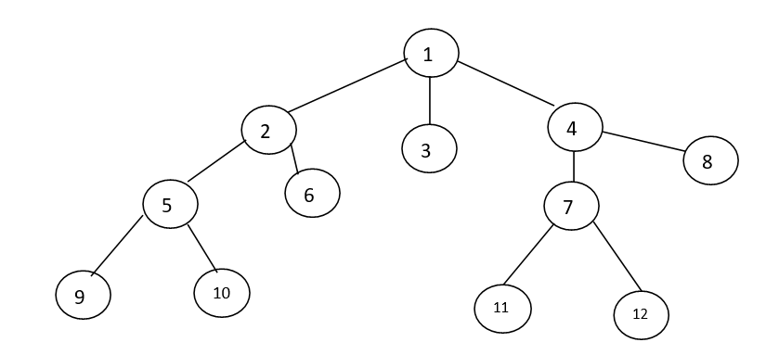
BFS (cont…)
Output:
1 2 3 4 5 6 7 8 9 10 11 12

Slide 5
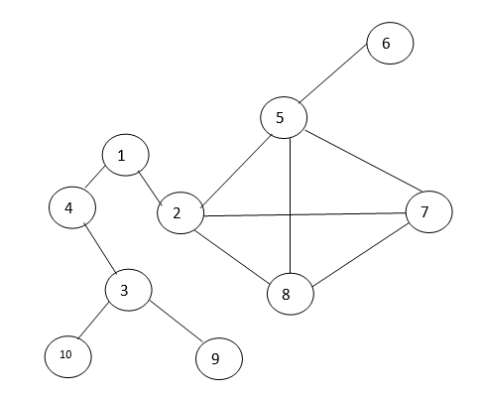
BFS(cont…)
BFS:
1 2 4 5 7 8 3 6 10 9

Slide 6
Depth First Search
DFS:
1 2 7 6 3 4 5

Slide 7
DFS(cont…)
DFS:
1 2 5 9 10 6 3 4 8 7 11 12

Slide 8
DFS (cont…)
DFS:
1 2 5 6 7 8 4 3 10 9

Slide 9
THANK
YOU

